Slide 1
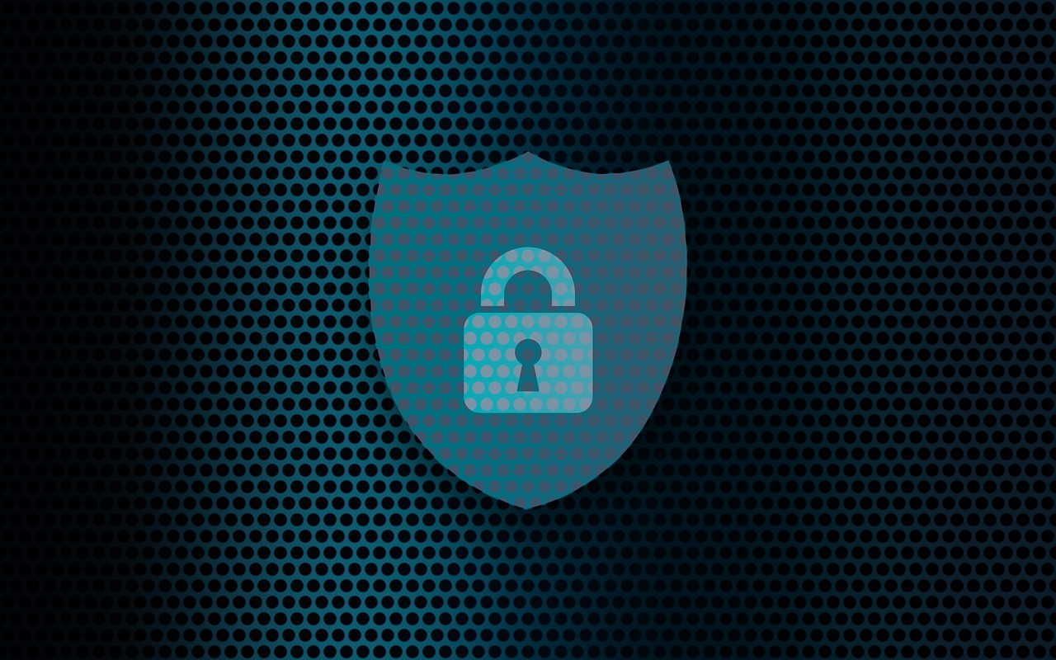
Wifi and Internet Security
By: Jonathan Kaufman
Christopher Newport University

Slide 2
Outline
Dangers of Using Public Wifi
How to Protect Yourself When Browsing
General Best Practices with using Wifi and Internet

Slide 3
Dangers of Using Public Wifi
Potentially a fake public Wifi Network setup by a hacker (Evil Twin Attack)
Hackers can sniff information being transmitted over the network
Can use this information to steal information and/or hack your accounts
https://goodspeed.io/blog/7-dangers-of-public-wifi.html
https://www.pandasecurity.com/en/mediacenter/security/what-is-an-evil-twin-attack/

Slide 4
Protecting Yourself on the Internet
Use anti-virus
Do not give out personal information on untrusted sites
Be careful of the sites you go to and the software that you download (Only go to https sites)
https://www.forbes.com/sites/tjmccue/2019/06/28/from-airports-to-the-library-5-steps-to-protect-yourself-on-free-public-wifi/?sh=64cf58412a02

Slide 5
Best Practices of Using Wifi
Avoid using Public Wifi whenever possible
If you want to protect yourself even more, use a VPN
Be careful of the networks you connect to
Do not put in any personal information or use any sensitive sites such as banking when using public wifi
https://www.forbes.com/sites/tjmccue/2019/06/28/from-airports-to-the-library-5-steps-to-protect-yourself-on-free-public-wifi/?sh=64cf58412a02

